Slide 1
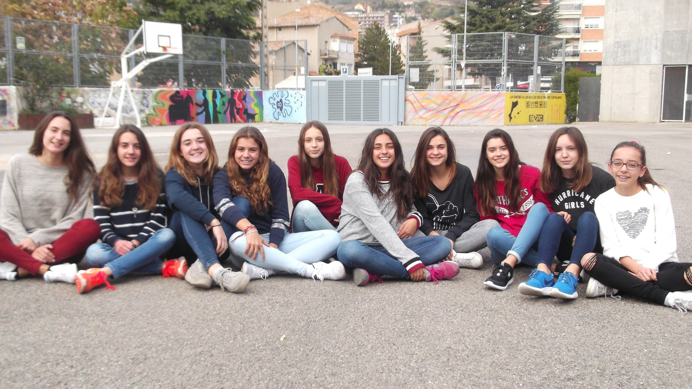
FEELING SCIENCE IN REAL LIFE

Slide 2
GETTING TO KNOW SCIENCE IN REAL LIFE

Slide 3
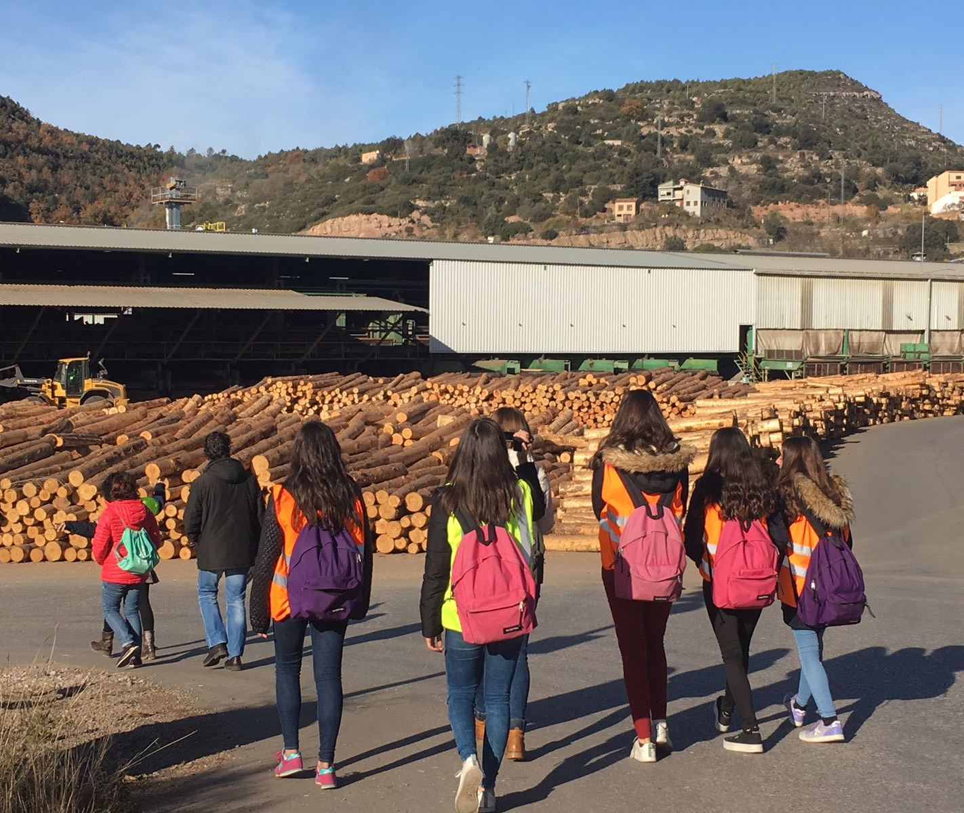
“Being a woman is not your impediment”

Slide 4
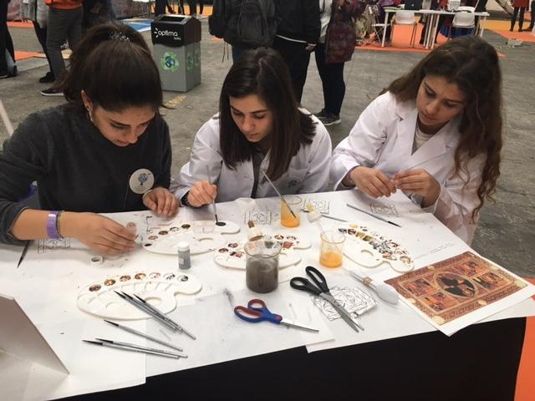
“There is currently a wide range of possibilities when it comes to working with Science and Technology”

Slide 5
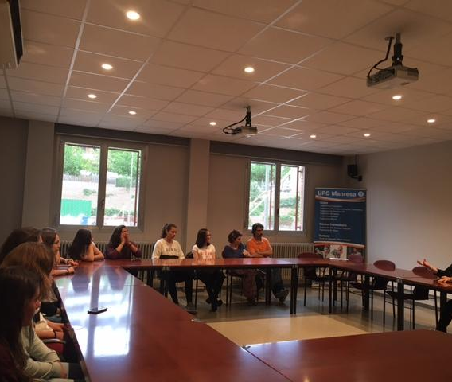
“Though things have always been done in a certain way, it does not mean they cannot be changed.”

Slide 6
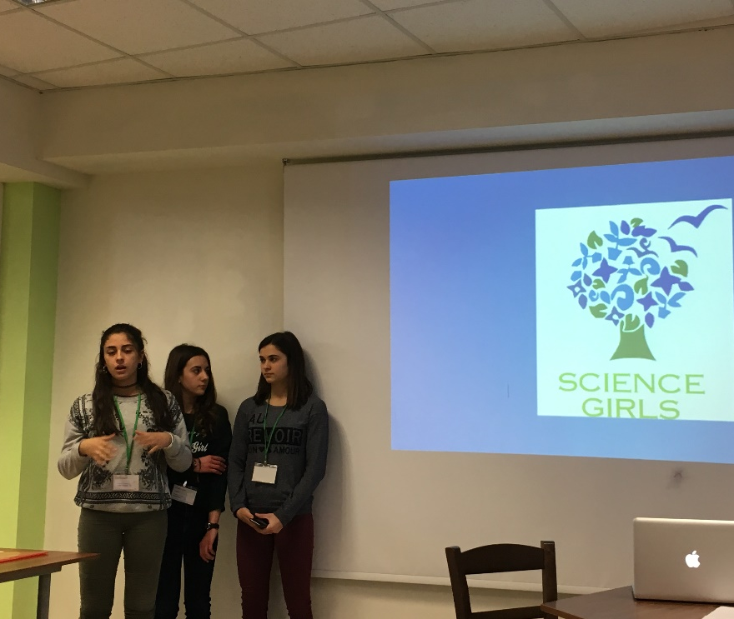
“You can help society and fulfill yourself”

Slide 7
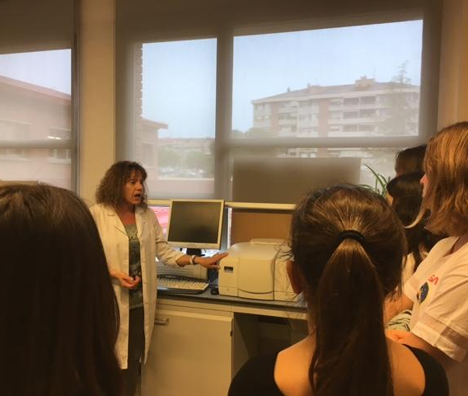
“If you study Science, you have the chance of learning many other
things”

Slide 8
SITE VISITS WHICH HELPED US IN SCIENCE

Slide 9
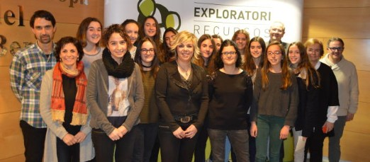
“Interviewing Role-models in a roundtable”

Slide 10
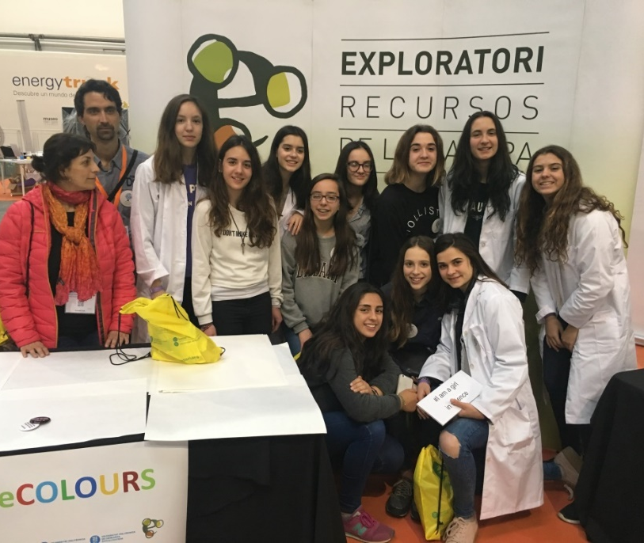
“Visiting the YOMO (The Youth Mobile Festival)”

Slide 11
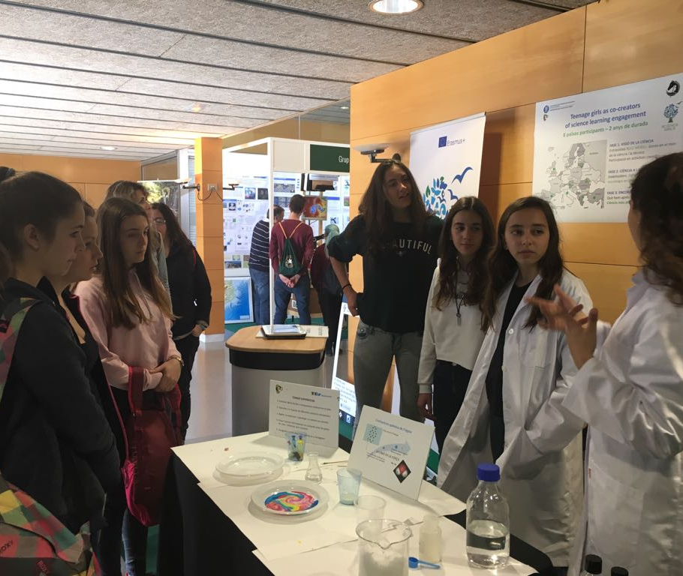
“Visit to the Knowledge Fair”

Slide 12
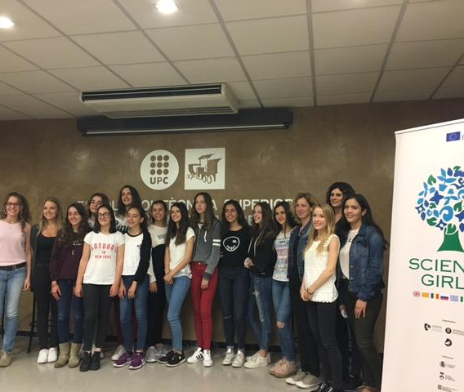
“Visit to the Polytechnic University in Catalonia ( UPC )”

Slide 13
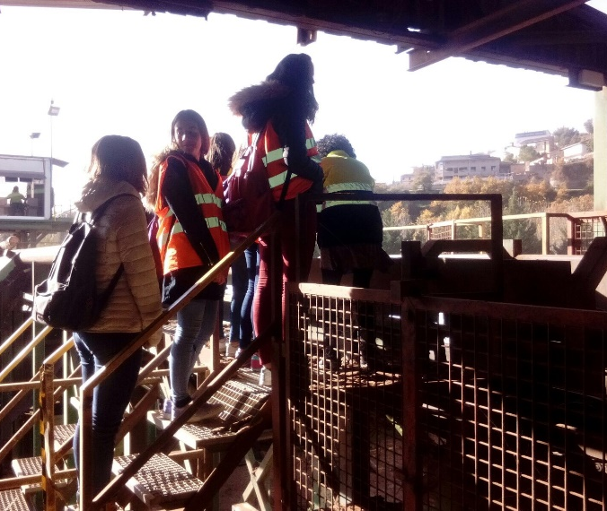
“Visiting Serradora Boix”

Slide 14
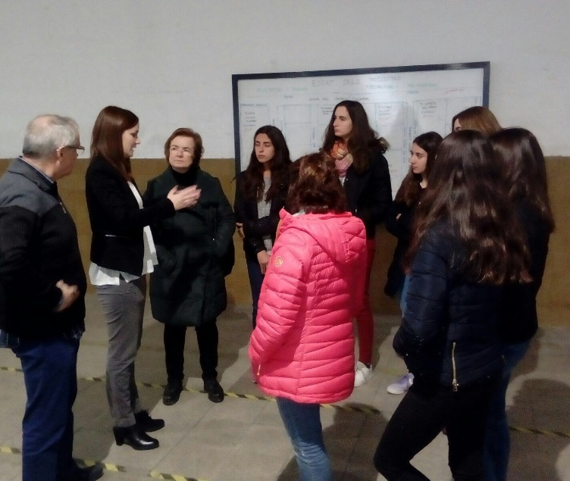
“Visiting Verserkal”

Slide 15
Partner meetings

Slide 16
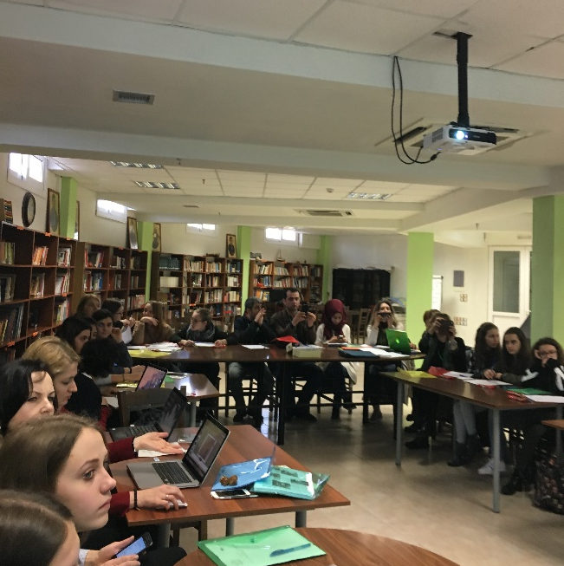
“Visiting Greece”

Slide 17
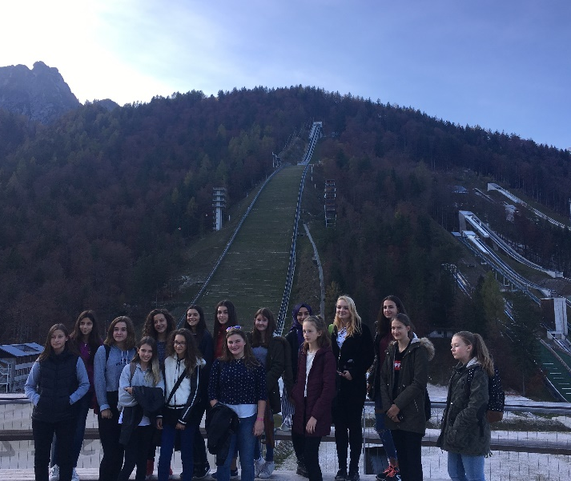
“Visiting Slovenia”

Slide 18
THANKS FOR YOUR ATTENTION!

