Slide 1
ScienceGirls – PM Greece

Slide 2
Our Team and location
UNIVERSITAT POLITÈCNICA DE CATALUNYA
Dr. Dolors Grau – Chemical Engineering Teacher
Dr. Josep Font – Mining Engineering Teacher
Headmasters of EXPLORATORI of natural resources
Ester Badia – Kelly Prieto
INSTITUT GUILLEM DE BERGUEDÀ
Ferran Cambrubí – Mathematical Teacher
Headmaster of Secondary School
Miquel Sabata – Health Vocational Training Teacher
Maribel Jodar – Geology Teacher
Alba Ballarà - Laura Baraut - Blanca Corominas
Núria Cunill - Judith Devers - Júlia Fígols
Judith Gonfaus - Marta Minoves - Júlia Solé
Tània Troya - Núria Vancell
ScienceGirls – PM Greece

Slide 3
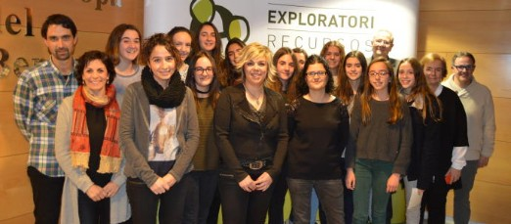
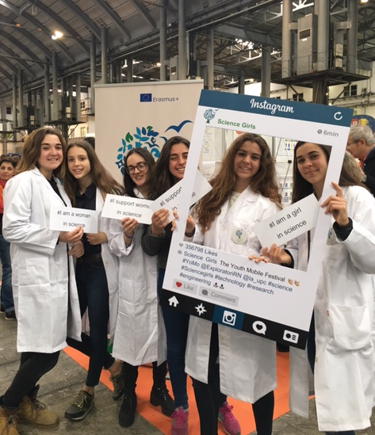
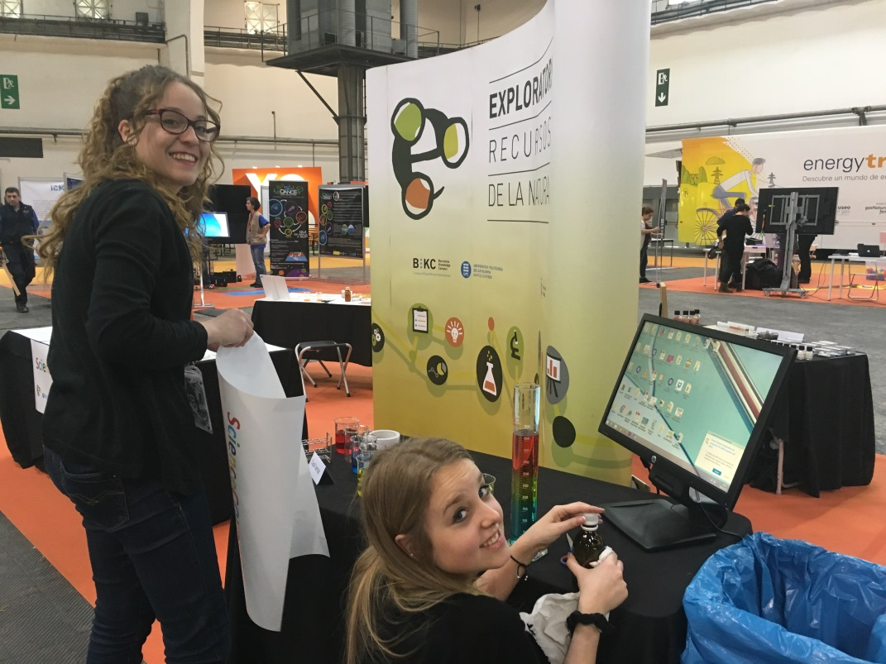
Ester and Kelly as research fellow
ScienceGirls – PM Greece

Slide 4
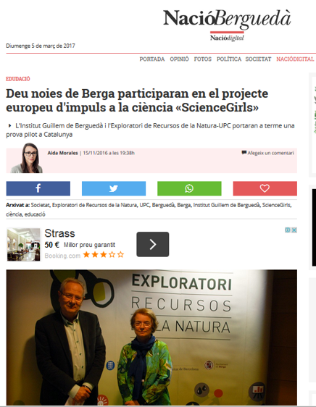
Impact on Press
TV:
http://tvbergueda.xiptv.cat/informatiu/capitol/presenten-a-berga-el-projecte-sciencegirls-per-apropar-la-ciencia-a-les-noies
https://youtu.be/jxGv8PWgWKg
ScienceGirls – PM Greece

Slide 5
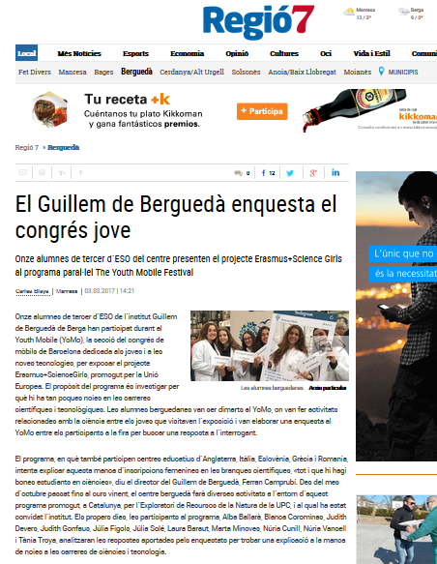
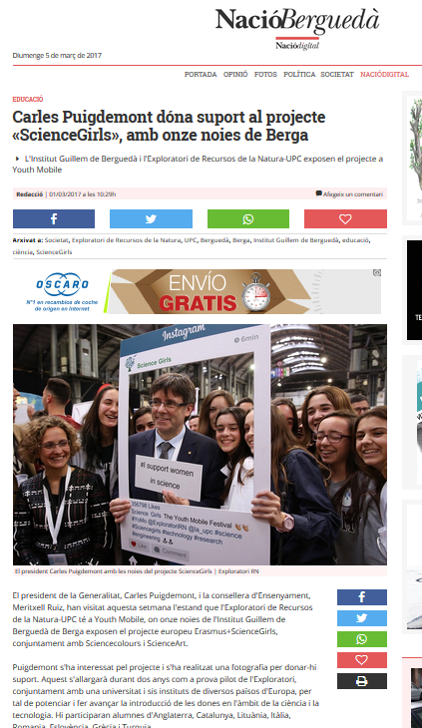
Impact on Press
ScienceGirls – PM Greece

Slide 6
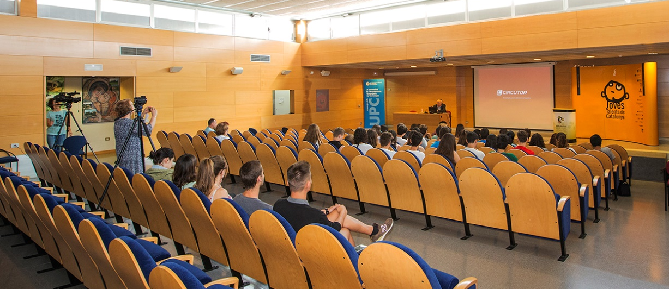
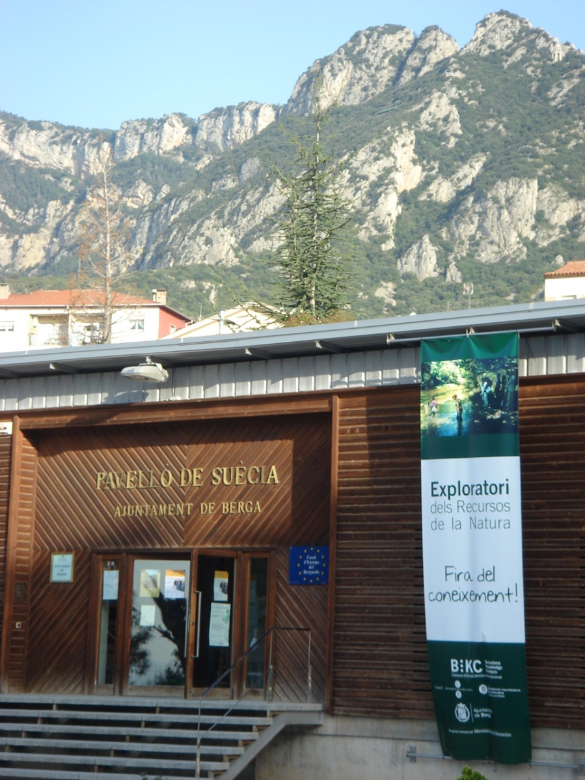
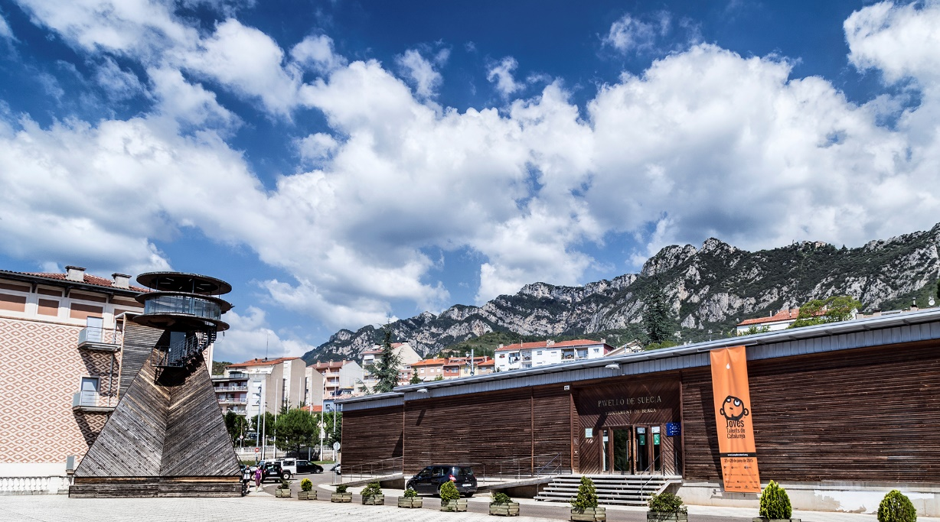
Science Visions Encounter
BERGA, February - March 2018

Slide 7
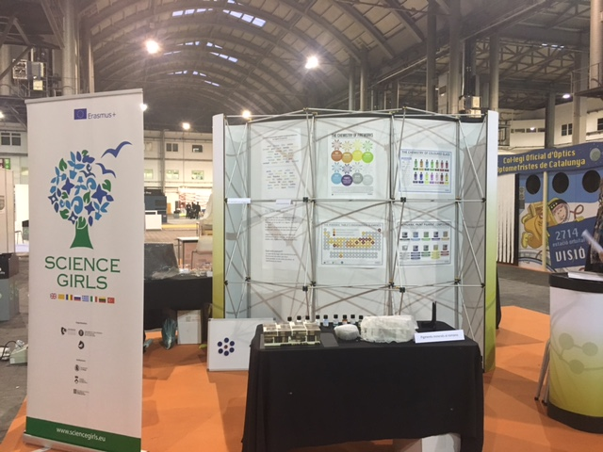
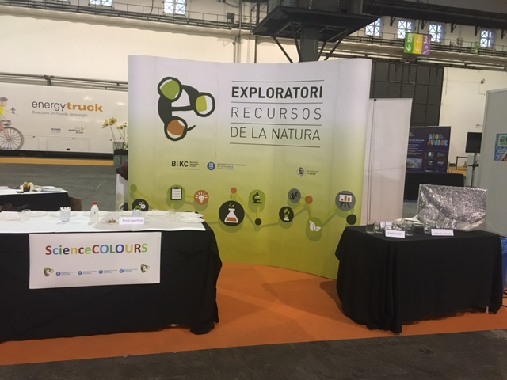
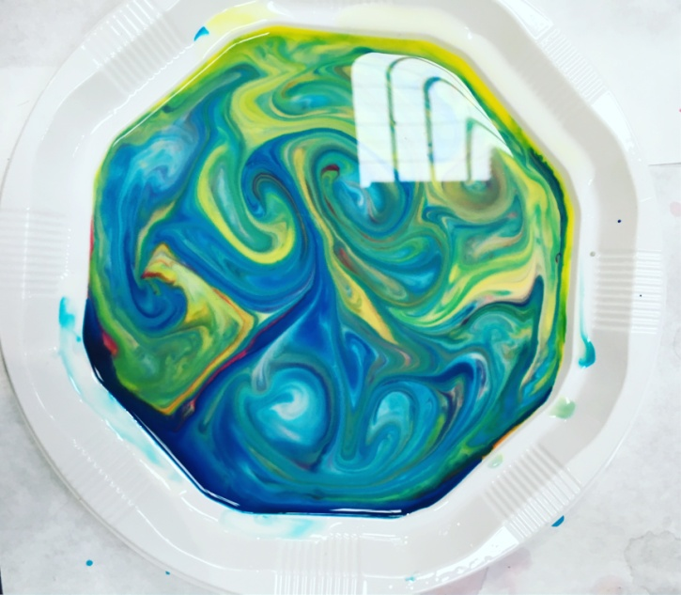
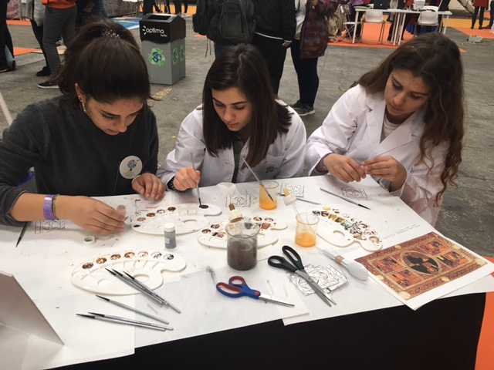
Science Visions Encounter
BARCELONA, February -March 2018
What is Youth Mobile? YoMo
Section of Young people in Barcelona Mobile World Congress
ScienceGirls – PM Greece

Slide 8
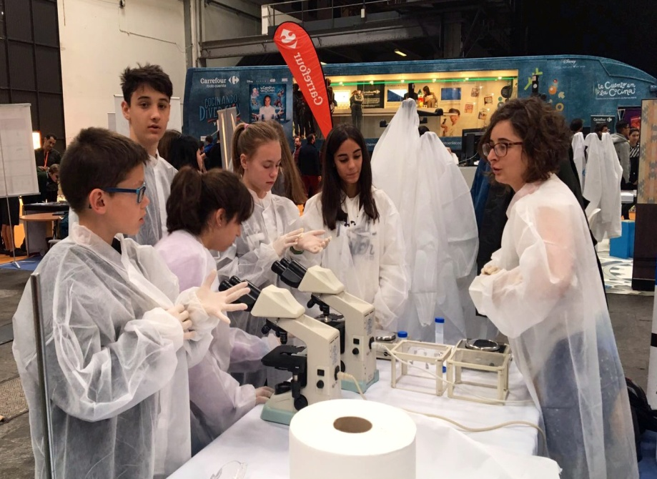
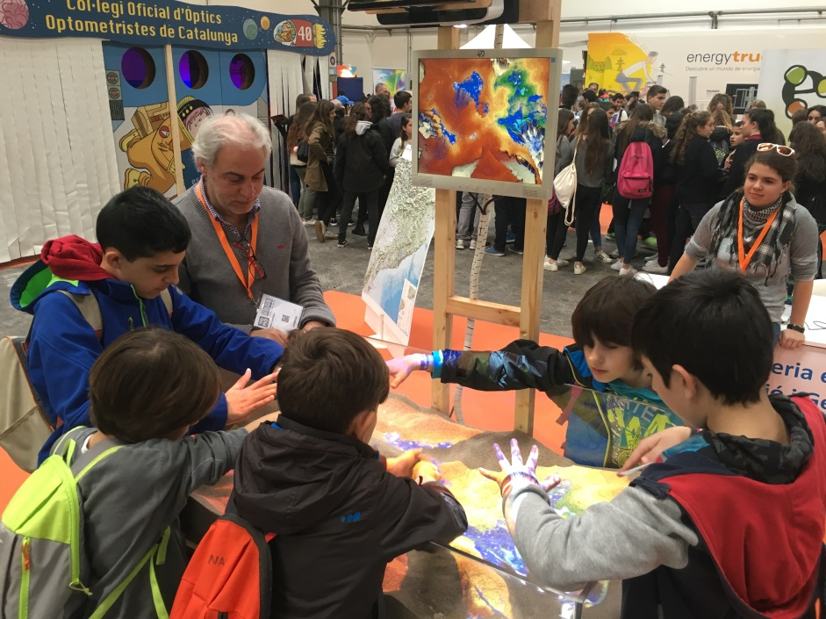
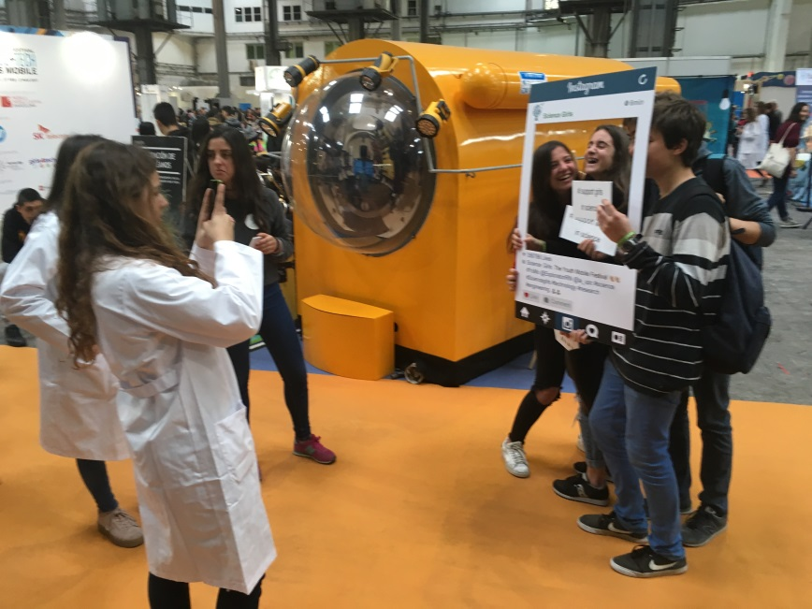
Science Visions Encounter
BARCELONA, February - March 2018
What is Youth Mobile? YoMo
Manager: Jeremy Buckle (Big Bang Fair in UK)
Our girls in action!

Slide 9
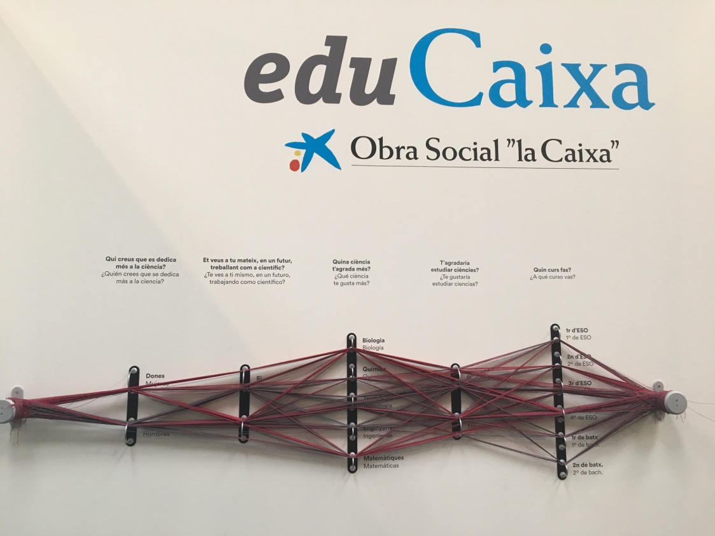
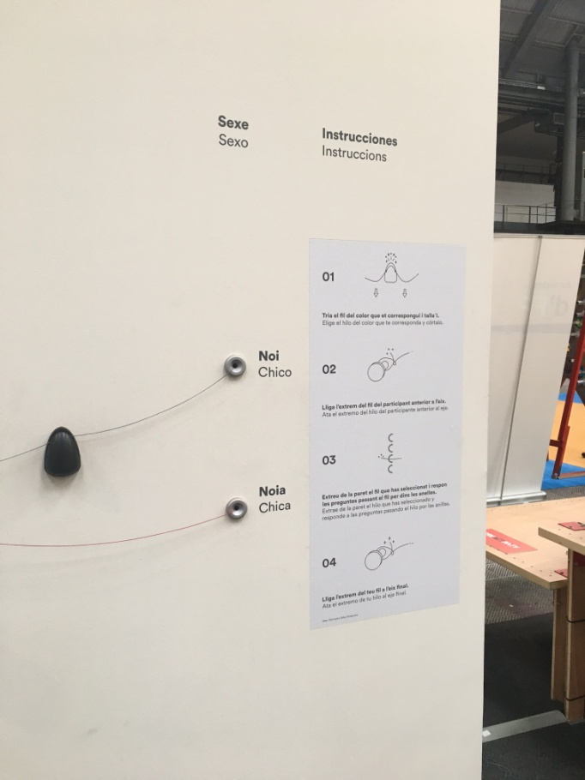
Science Visions Encounter
BARCELONA, February - March 2018
What is Youth Mobile? YoMo
Section of Young people in Barcelona Mobile World Congress
What kind of science do you like most?
Would you like study SCIENCE?
In the future, do you think that you would work as a Scientist?
Who you think that work more as a Scientist?
Level
BOY
GIRL
Project of co-creation about gender in YoMo
ScienceGirls – PM Greece

Slide 10
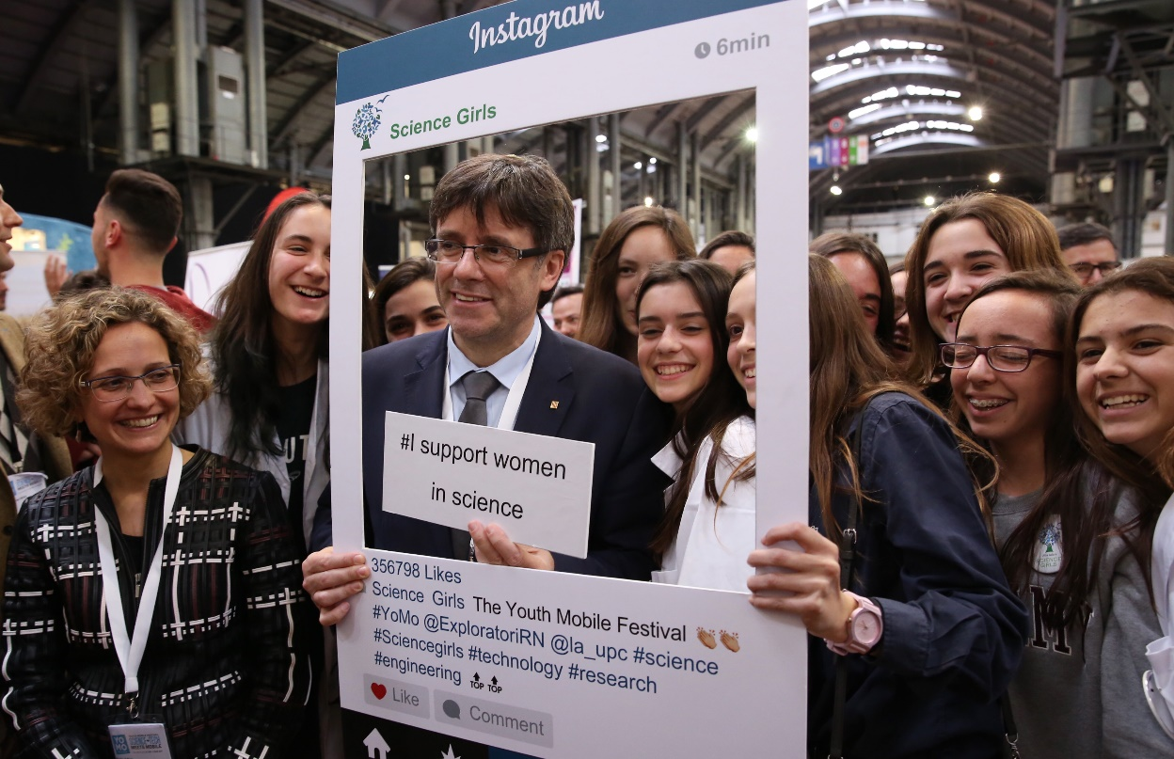
Our Experience in YoMo 2017
Video
Video2
Instagram of own President: https://www.instagram.com/p/BRD6OYPhe2R/ Twitter of delegation of Catalan Government in USA: https://twitter.com/i/web/status/836612236143656961
ScienceGirls – PM Greece

Slide 11
Our Experience in YoMo 2017
Results of questionnaire
2. LEVEL
1. GENDER
CHEMISTRY
OTHER
ScienceGirls – PM Greece

Slide 12
Our Experience in YoMo 2017
Results of questionnaire
ScienceGirls – PM Greece

Slide 13
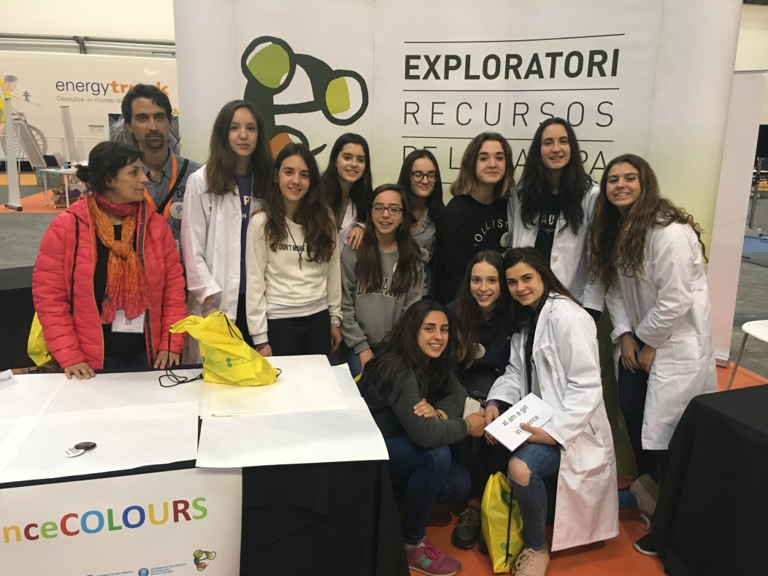
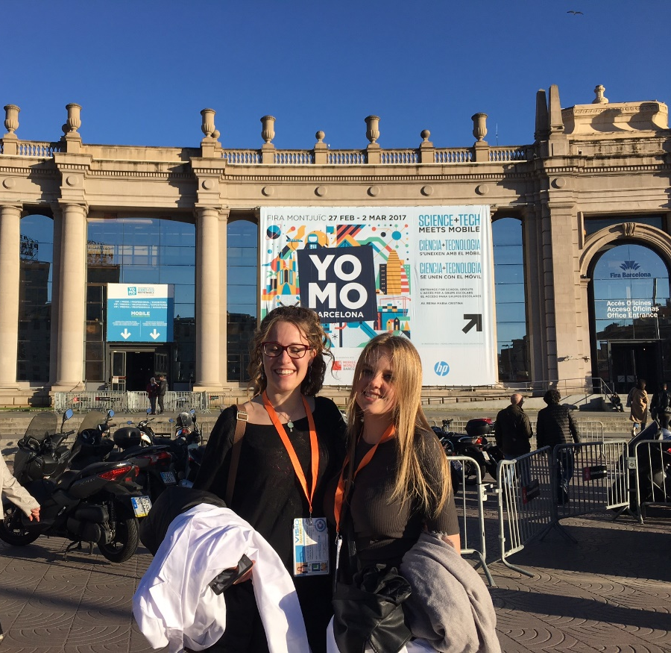
Our Experience in YoMo 2017
ScienceGirls – PM Greece

Slide 14
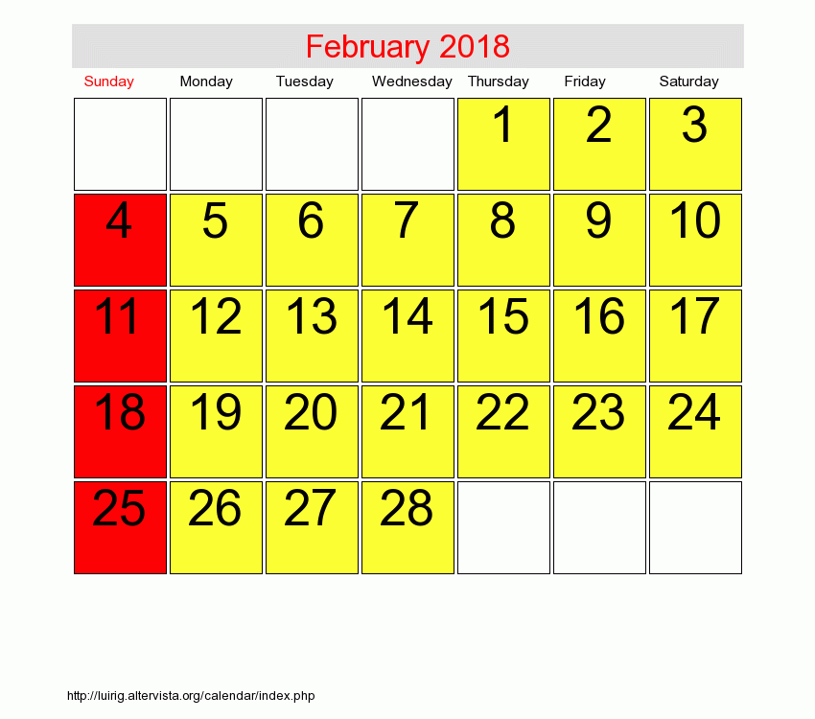
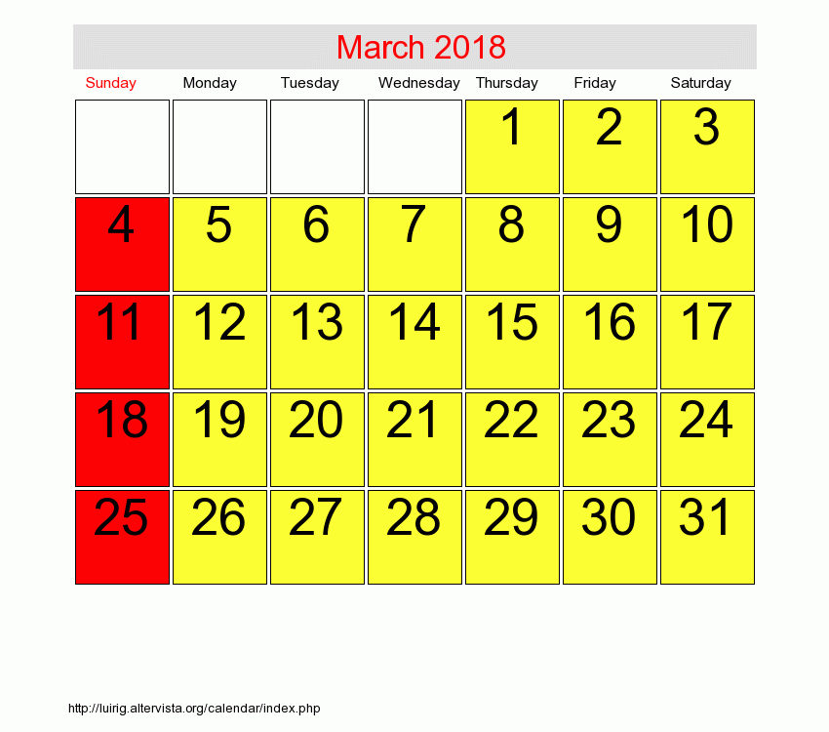
Science Visions Encounter
Is it interesting to participate in YoMo 2018?
Dates:
Barcelona Mobile World Congress 2018: 26th February to 1st March
YoMo:
1st edition with great success
At the moment YoMo doesn’t confirm same dates for 2018
They are going to study results of 1st edition in order to decide next edition
If it is confirmed 2n edition of YoMo – Proposal of dates:
Arrival: February 25th
Work in Berga: February 26 to 28
Participation in YoMo: March 1st
Departure: March 2nd
ScienceGirls – PM Greece

Slide 15
Thank you!
www.exploratori.org
@ExploratoriRN
ScienceGirls – PM Greece

